Slide 1
Consumption, Saving and Investment
Aditi Chaubal
aditi@hss.iitb.ac.in
HS101 – Economics (Macroeconomics) - 2019

Slide 2
Outline
Consumption, Savings, Investment
Consumption function
Savings function
Marginal propensity to consume (MPC): Calculation & interpretation
Marginal propensity to save (MPS): Calculation & interpretation
MPS ≡ 1 – MPC
Determinants of consumption
Determinants of investment
Investment demand curve
Aggregate demand: Introduction
HS101 – Economics (Macroeconomics) - 2019

Slide 3
Role of consumption and investment
Consumption (C) and investment (I) – major components of national income [India: C ~ 67% + I ~ 34 % = 90% of GDP (2017-18)]
Low C + high I => Rapid growth of output and income
High C + low I => Slow growth of output and income
Importance of consumption and investment dynamics
Understand determination of aggregate demand (AD) in the short-run
Economic conditions can result in rapid increase (decline) in consumption and investment => increase (decrease) in AD
Business cycle: short-run fluctuations in output, income and unemployment in terms of total national output, leading to expansion or contraction in most sectors of the economy.
Dynamics between consumption, saving and income
HS101 – Economics (Macroeconomics) - 2019
Notes:
C = PFCE +GFCE
Short-run: Period in which firms can adjust production by changing variable factors of production (raw materials, labour) excluding changes in capital.

Slide 4
Major components of PFCE
Data source: Press Note on First Revised Estimates of National Income, Consumption Expenditure, Saving And Capital Formation for 2017-18, CSO, MOSPI (Jan 2019)

Slide 5
Consumption in India
Aggregating individual consumption patterns
=> Aggregate consumption behavior
PFCE disaggregation (2015-16):
47.4% on services (rent, water bill, medical services, education, restaurants, etc)
41% on non-durable goods (food, beverages, fuel, newspaper etc.)
8.3% on semi-durable goods (clothing, footwear, utensils, stationary, etc.)
3.3% on durable goods (furniture, TV, refrigerator, jewellery, etc.)
HS101 – Economics (Macroeconomics) - 2019
Notes:
Recall C= hhd consumption of final goods and services for meeting needs or satisfaction by use
Recall hhd Savings: part of disposable income not spent on consumption

Slide 6
Gross Savings as a share of GDP
Data source: State of the Economy in 2018-19: A Macro View, Economic Survey 2018-19 (Chapter 1, Vol. 2)
HS101 – Economics (Macroeconomics) - 2019

Slide 7
Consumption
People with lower incomes spend largely on food, shelter, clothing
As incomes increase:
Expenditure on food increases (quantity and quality) – up to a limit
Limit on amount of extra income spent on food: Proportion of total expenditure on food declines with further increase in income
Expenditure on other items (clothing, recreation, education, etc.) increases
Proportion of spending on luxury items increases with increase in income
Biggest luxury ?
HS101 – Economics (Macroeconomics) - 2019

Slide 8
Consumption – Concepts
Engel elasticity (EE): Measure to analyse consumer behavior with regard to a commodity. It measures responsiveness of consumption of a particular commodity to total consumption.
Engel elasticity < 1 => as income increases, spending on the commodity declines
E.g. EE (meat, eggs, fish, vegetables, etc.) > EE (breads, cereals, pulses, etc.)
India (Economic Survey 2017-18): Engel elasticity of
Food significantly < 1
Health significantly > 1
Education little < 1
HS101 – Economics (Macroeconomics) - 2019
Notes:
Engel law – plot of DI (X-axis) vs personal consumption expenditure (Y-axis)

Slide 9
Consumption – Concepts
Income is the primary determinant of consumption and savings (economy)
Recall: S = DI – C or C + S = DI
Higher income households save more in absolute and % terms of income
Lower income households save less or may dissave (spend more than they earn through borrowings or drawing on accumulated savings)
HS101 – Economics (Macroeconomics) - 2019

Slide 10
Consumption function
Relation (graph) between the level of consumption expenditure and level of personal disposable income
Based on the hypothesis that there exists a stable empirical relation between consumption and income
Graphical interpretation: For every level of DI, the consumption function provides the Rupee level of consumption for a household.
Break-even point: The point at which a household neither saves nor dissaves i.e. consumes all its income.
Assumption: Whatever a household does not consume, it saves (DI – C = S)
HS101 – Economics (Macroeconomics) - 2019
Notes:
Concept of Consumption function introduced by Keynes

Slide 11
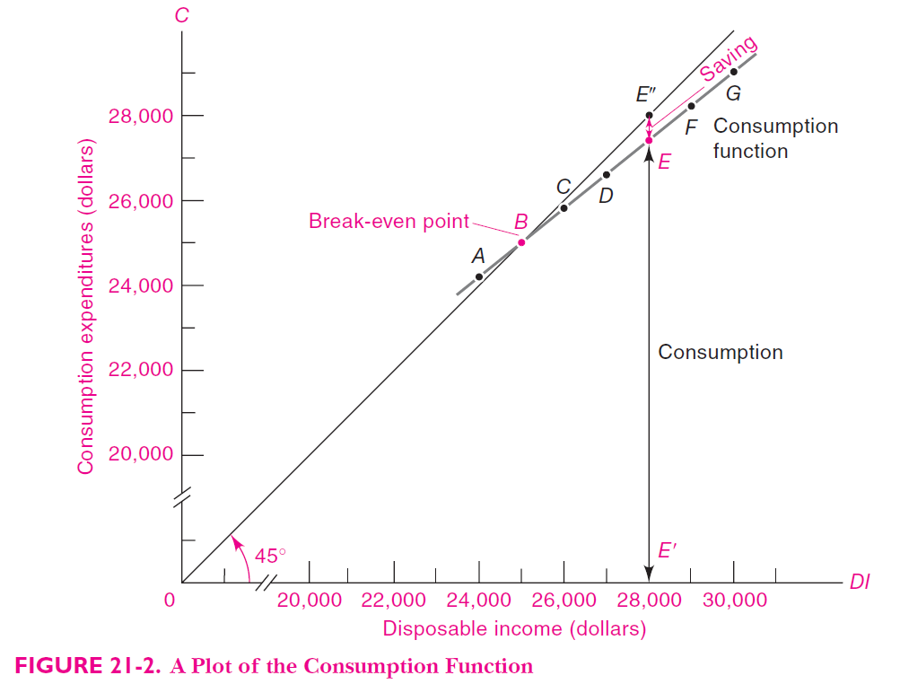
Consumption Function (Ref: Samuelson and Nordhaus, Economics (19th Edition)
(28000 – Saving)
Dissaving

Slide 12
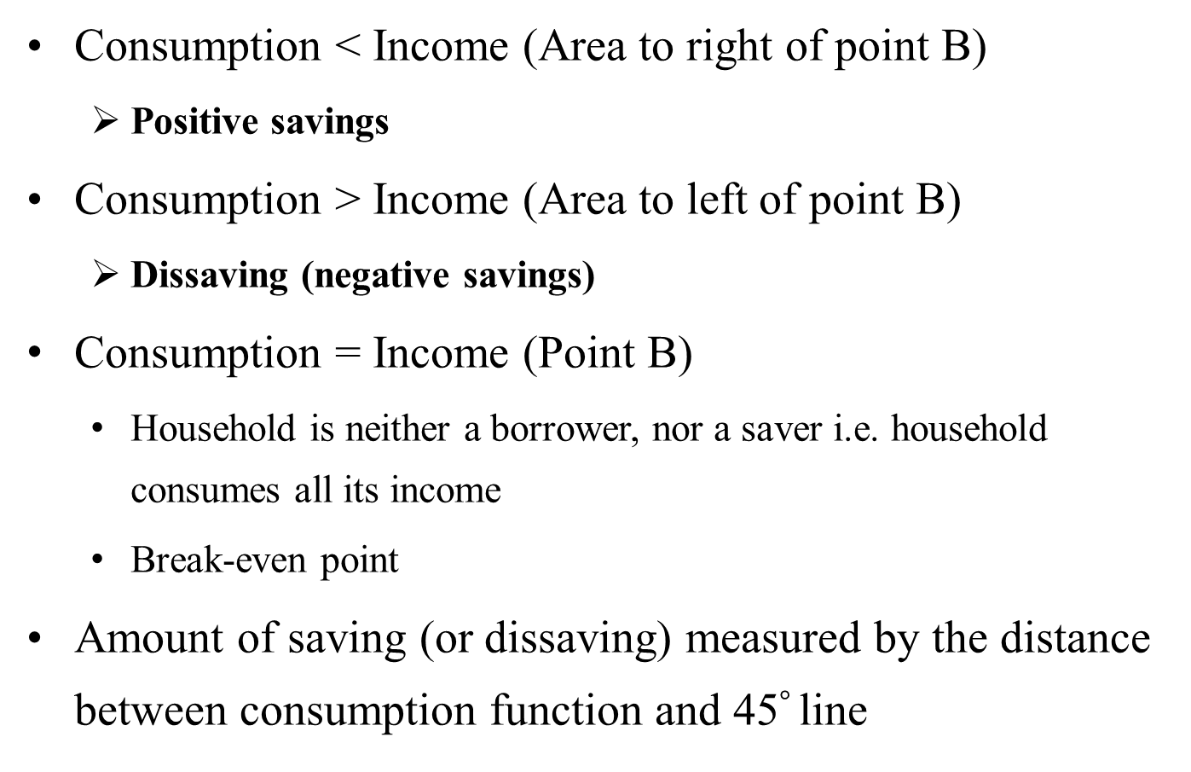
Consumption function
Consumption < Income (Area to right of point B)
Positive savings
Consumption > Income (Area to left of point B)
Dissaving (negative savings)
Consumption = Income (Point B)
Household is neither a borrower, nor a saver i.e. household consumes all its income
Break-even point
Amount of saving (or dissaving) measured by the distance between consumption function and 45$°$ line
HS101 – Economics (Macroeconomics) - 2019

Slide 13
Savings Function
Household savings: part of DI not spent on consumption
Relation (graph) between level of net savings and personal disposable income
Savings function is derived from the consumption function (assumption: S= DI – C)
Savings function is a mirror image of the consumption function
Savings > 0 (Points to right of point B)
Positive savings
Consumption < Income => S > 0
Savings < 0 (Points to left of point B)
Dissaving (negative savings)
Consumption > Income => S < 0
HS101 – Economics (Macroeconomics) - 2019

Slide 14
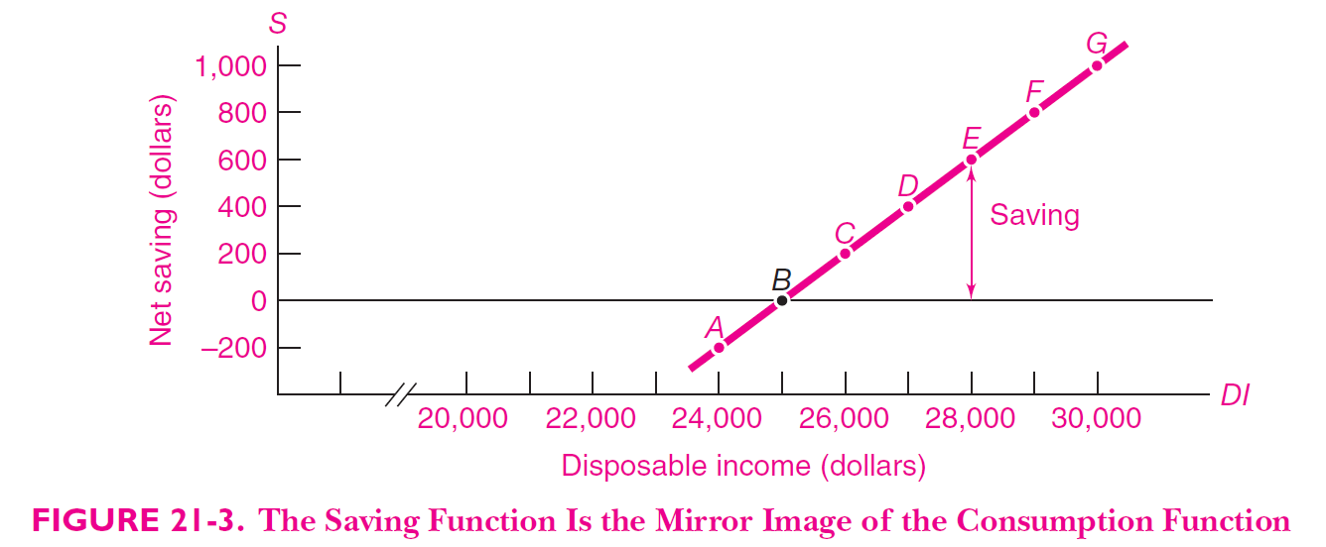
Savings Function (Ref: Samuelson and Nordhaus, Economics (19th Edition)
HS101 – Economics (Macroeconomics) - 2019

Slide 15
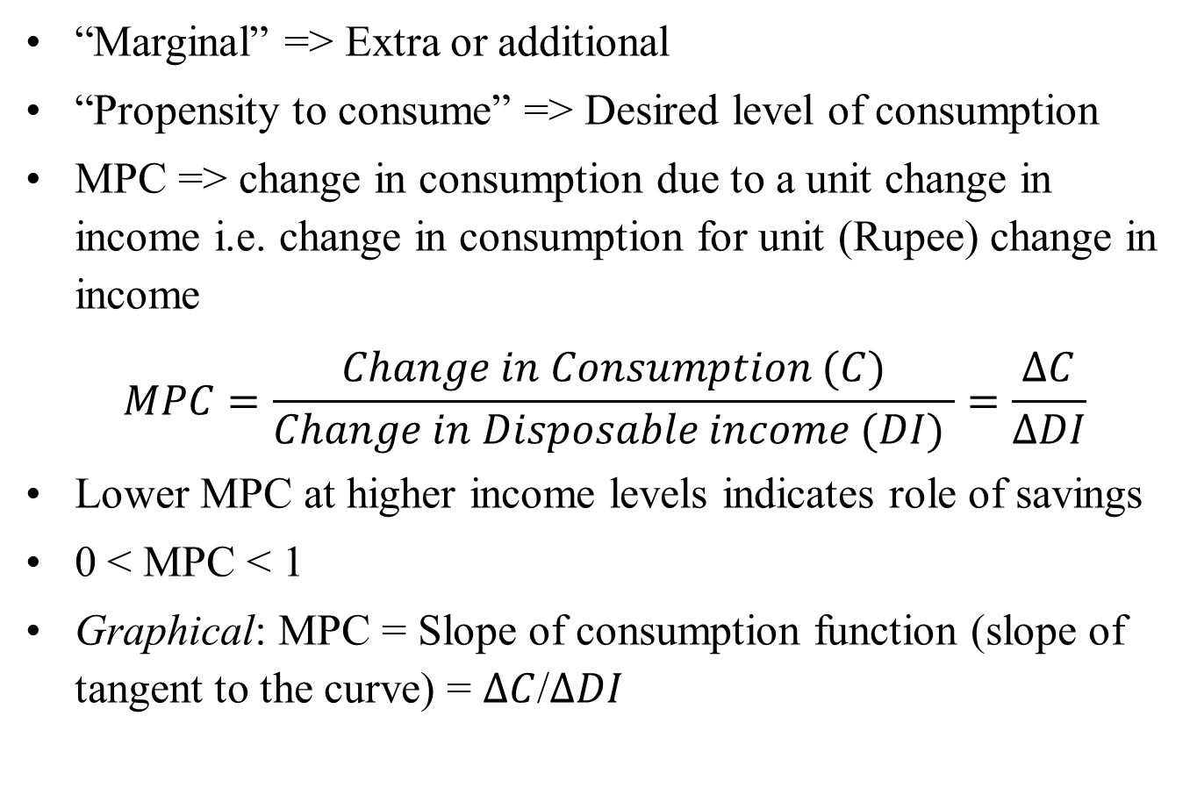
Marginal Propensity to Consume (MPC)
“Marginal” => Extra or additional
“Propensity to consume” => Desired level of consumption
MPC => change in consumption due to a unit change in income i.e. change in consumption for unit (Rupee) change in income
$$MPC=\frac{Change in Consumption (C)}{Change in Disposable income (DI) }=\frac{∆C}{∆DI}$$
Lower MPC at higher income levels indicates role of savings
0 < MPC < 1
Graphical: MPC = Slope of consumption function (slope of tangent to the curve) = $∆C$/$∆DI$
HS101 – Economics (Macroeconomics) - 2019

Slide 16
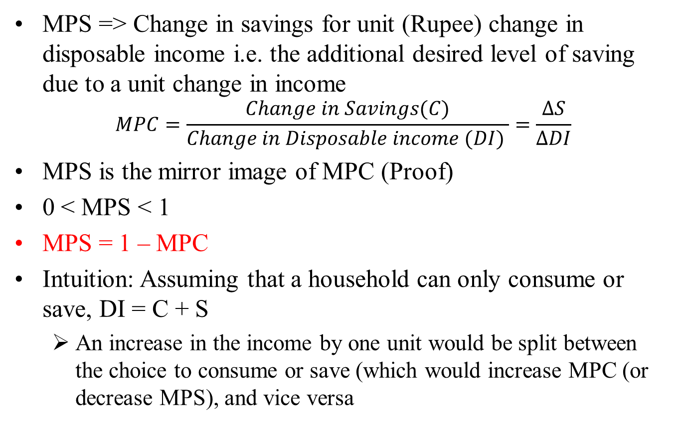
Marginal Propensity to Save (MPS)
MPS => Change in savings for unit (Rupee) change in disposable income i.e. the additional desired level of saving due to a unit change in income
$$MPC=\frac{Change in Savings(C)}{Change in Disposable income (DI) }=\frac{∆S}{∆DI}$$
MPS is the mirror image of MPC (Proof)
0 < MPS < 1
MPS = 1 – MPC
Intuition: Assuming that a household can only consume or save, DI = C + S
An increase in the income by one unit would be split between the choice to consume or save (which would increase MPC (or decrease MPS), and vice versa
HS101 – Economics (Macroeconomics) - 2019

Slide 17
MPC and MPS example
Household | Disposable income (DI) (Rs) | Consumption Expenditure (C) (Rs) | MPC = ΔC/ΔDI | Net Saving = DI - C | MPS = ΔS/ΔDI | MPC+MPS
A | 24000 | 24110 |  | -110
B | 25000 | 25000 | 0.89 | 0 | 0.11 | 1
C | 26000 | 25850 | 0.85 | 150 | 0.15 | 1
D | 27000 | 26600 | 0.75 | 400 | 0.25 | 1
E | 28000 | 27240 | 0.64 | 760 | 0.36 | 1
F | 29000 | 27830 | 0.59 | 1170 | 0.41 | 1
G | 30000 | 28360 | 0.53 | 1640 | 0.47 | 1

Slide 18
India: MPC and MPS [Data at current prices (in Rs. crores) Data Source: National Accounts Statements, MOSPI (Jan 2018)]
Year | PFCE | GFCE | Gross Saving | GNDI | Total C | MPC | MPS
2011 | 4910447 | 968375 | 3026837 | 8964407 | 5878822
2012 | 5614484 | 1062404 | 3369202 | 10177331 | 6676889 | 0.66 | 0.28
2013 | 6475649 | 1156509 | 3608193 | 11489556 | 7632158 | 0.73 | 0.18
2014 | 7247340 | 1301762 | 4019957 | 12725683 | 8549102 | 0.74 | 0.33
2015 | 8091249 | 1427835 | 4301948 | 14017341 | 9519085 | 0.75 | 0.22
2016 | 9004904 | 1663836 | 4572573 | 15456822 | 10668741 | 0.80 | 0.19
HS101 – Economics (Macroeconomics) - 2019

Slide 19
National consumption behaviour
National consumption behavior essential to understanding short-run business cycles and long-run economic growth
Short-run: Consumption is major component of expenditure;
changes in C impact AD by affecting output and employment
Long-run: Capital is the major component driving growth –
Consumption behavior matters as:
Saving = what is not consumed (and is thus available for investment in form of capital)
National Consumption Function: Relation between National Disposable Income and Consumption Expenditure at different points in time.
It gives the Gross National DI and the corresponding Consumption expenditure at different points in time.
HS101 – Economics (Macroeconomics) - 2019

Slide 20
Determinants of Consumption (Theories)
Consumption depends on:
Disposable income (current + future)
Relation between consumption and future trends of disposable income
Permanent Income Hypothesis
Life-cycle Hypothesis
HS101 – Economics (Macroeconomics) - 2019

Slide 21
Permanent income hypothesis
Permanent income: level of income which households receive after removing or accounting for transient/temporary impacts and influences
Hypothesis: Current consumption is primarily determined by permanent income
Consumers do not respond to all (temporary and permanent) income shocks
Permanent positive (negative) income shock => consumers would increase (decrease) current consumption expenditure
Temporary positive income shock => consumers would be inclined to save a significant fraction of additional income
HS101 – Economics (Macroeconomics) - 2019

Slide 22
Life-cycle hypothesis
Hypothesis: People save today to smooth consumption over their expected lifetimes.
People save while working (today) to have income during later years (when not working).
HS101 – Economics (Macroeconomics) - 2019

Slide 23
Other determinants of consumption
Wealth effect: Amount of existing wealth determines consumption
Changes in wealth (higher wealth) lead to change (higher) in consumption
HS101 – Economics (Macroeconomics) - 2019

Slide 24
Investment
Private spending = Consumption + Investment (I)
I => Gross private domestic investment
2 roles of investment
Short-run (SR): impact on SR output and employment (through influence on AD)
Long-run (LR): impact on LR output growth through impact on capital formation
Total national investment = I + foreign investment + government investment + intangible investments
Majority of investment: fixed investments (90%) (dwellings, machinery + equipment, others)
Why do businesses invest? (Revenues > Costs)
Determinants of investment: Revenues, Costs, Business expectations
HS101 – Economics (Macroeconomics) - 2019

Slide 25
Determinants of investment
Revenues: Investments which increase sales of firms help bring additional revenue
Investment depends on overall state of economic activity
Investment level is sensitive to the business cycle
Accelerator principle
Rate of investment is primarily determined by rate of change of output
Directly proportional:
Growing output => ↑ Investment
Falling output => ↓ Investment
HS101 – Economics (Macroeconomics) - 2019

Slide 26
Determinants of investment
Cost of investment: Costs determine investment as costs would need to offset the return from investment
Calculating cost of investment – complex owing to the lasting nature of investment
Cost of investment depends on:
Price of capital good
Cost of borrowing => ?
Tax rates imposed on businesses
HS101 – Economics (Macroeconomics) - 2019

Slide 27
Determinants of investment
Business expectations and confidence: Expectations of the returns on investment (revenue) determine the investment levels
Investment is determined by:
Expectation of revenue exceeding costs (profits)
Likelihood of slowdown or recovery
Summarizing determinants of investment:
Demand for output produced by new investment
Interest rates and tax rates
Business expectations about state of economy
HS101 – Economics (Macroeconomics) - 2019

Slide 28
Investment demand curve
Relation between interest rates and investment
Assumptions:
Durable investments (no replacement required)
Investment leads to constant flow of net income
No inflation
Investment demand: Total investment across projects with positive profits (= revenue – costs)
Investment demand curve (downward sloping) gives the amount of investment (profitable) at every interest rate
HS101 – Economics (Macroeconomics) - 2019

Slide 29
Shifts in investment demand curve
Interest rates
↑ interest rate => ↓ investment
=> investment demand curve shifts left
Tax rates
↑ taxes => ↓ investment
=> investment demand curve shifts left
Business expectations
↑ business confidence => ↑ investment
=> investment demand curve shifts right
HS101 – Economics (Macroeconomics) - 2019

Slide 30
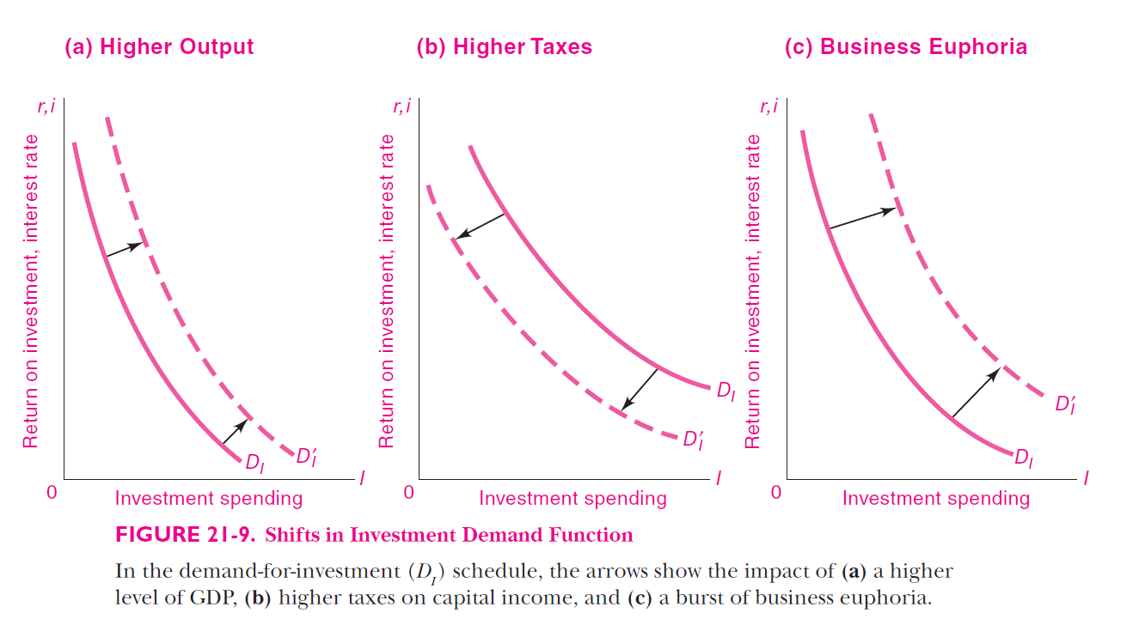
Shifts in investment demand curve
HS101 – Economics (Macroeconomics) - 2019

Slide 31
Thank You

